Slide 1

Electronic Devices
Lab Lecture 2
This document might contain some excerpts and pictures from various books and other sources. The author doesn’t claim any rights to the topics discussed in this video. This topics has been presented in a way to help out students in BRAC university, Bangladesh

Slide 2
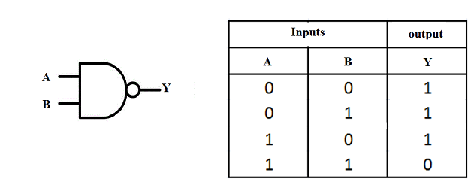
Diode-Transistor Logic Gates
Diode-Transistor logic or DTL logic is the direct descendent of DL logic.
In DTL system logic function is performed by a diode network and amplifying function is done by a transistor.

Slide 3
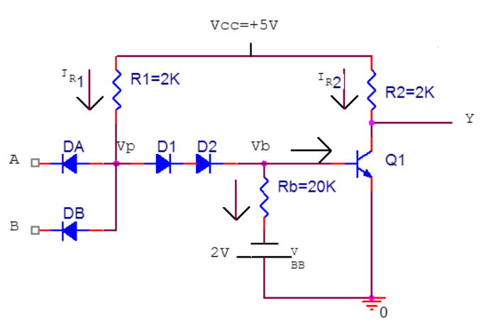
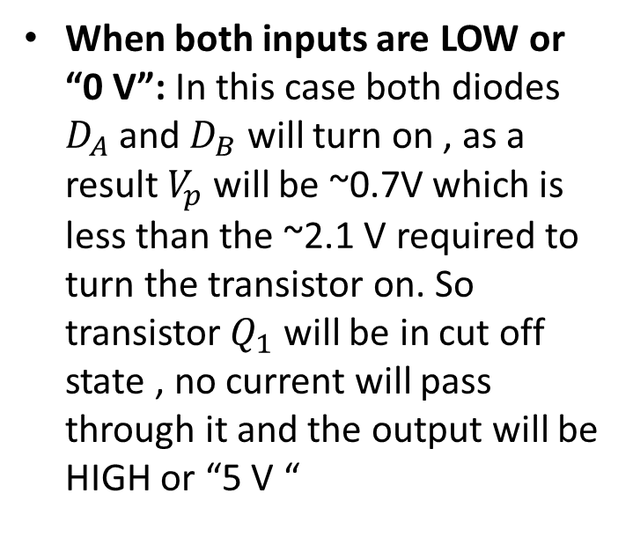
Diode-Transistor Logic NAND Gate
When both inputs are LOW or “0 V”: In this case both diodes $D_{A}$and $D_{B}$ will turn on , as a result $V_{p}$ will be ~0.7V which is less than the ~2.1 V required to turn the transistor on. So transistor $Q_{1}$ will be in cut off state , no current will pass through it and the output will be HIGH or “5 V “

Slide 4
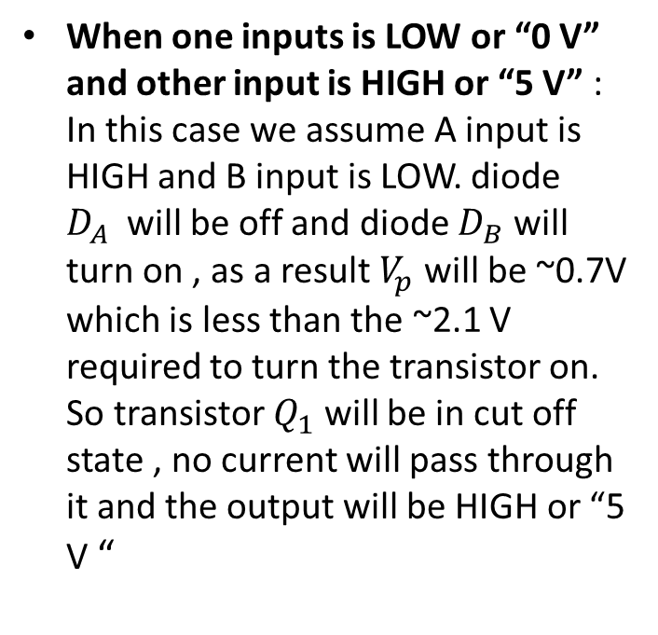
Diode-Transistor Logic NAND Gate
When one inputs is LOW or “0 V” and other input is HIGH or “5 V” : In this case we assume A input is HIGH and B input is LOW. diode $D_{A}$will be off and diode $D_{B}$ will turn on , as a result $V_{p}$ will be ~0.7V which is less than the ~2.1 V required to turn the transistor on. So transistor $Q_{1}$ will be in cut off state , no current will pass through it and the output will be HIGH or “5 V “

Slide 5
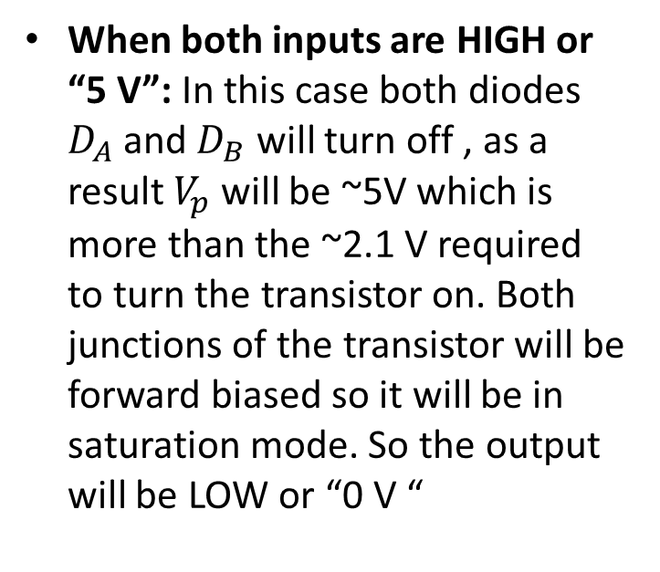
Diode-Transistor Logic NAND Gate
When both inputs are HIGH or “5 V”: In this case both diodes $D_{A}$and $D_{B}$ will turn off , as a result $V_{p}$ will be ~5V which is more than the ~2.1 V required to turn the transistor on. Both junctions of the transistor will be forward biased so it will be in saturation mode. So the output will be LOW or “0 V “

Slide 6
Diode-Transistor Logic NAND Gate
Input A | Input B | Output Y
0 | 0 | HIGH
0 | 5(HIGH) | HIGH
5(HIGH) | 0 | HIGH
5(HIGH) | 5(HIGH) | LOW

Slide 7
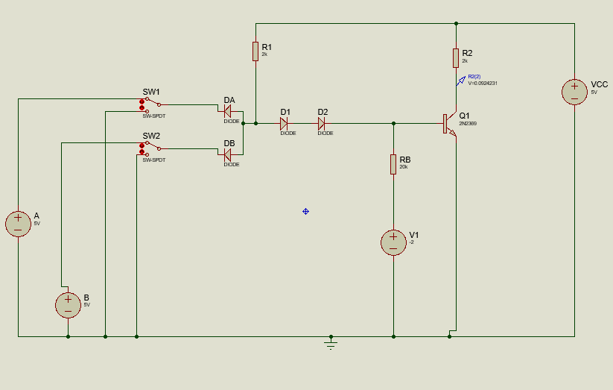
Simulation
Figure : Schematic of DTL NAND gate

